Slide 1
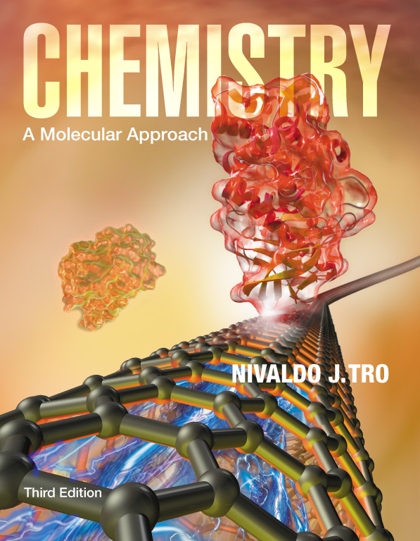
Lecture Presentation
Chapter 24
Transition Metals and Coordination Compounds
Sherril Soman
Grand Valley State University

Slide 2
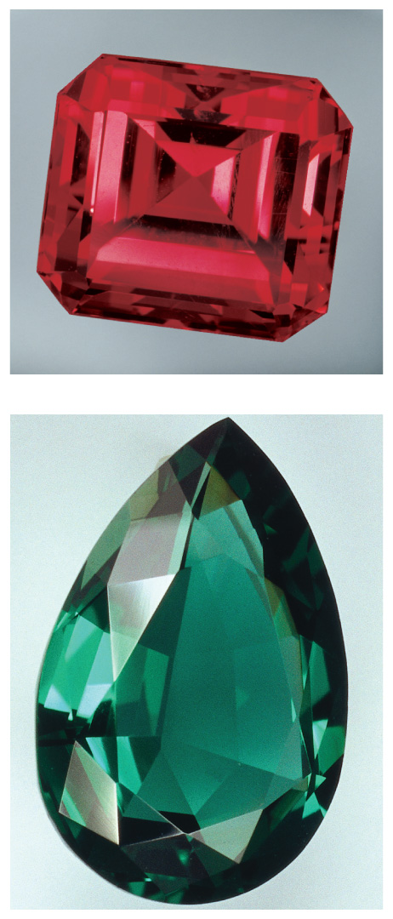
Gemstones
The colors of rubies and emeralds are both due to the presence of Cr³⁺ ions; the difference lies in the crystal hosting the ion.
Some Al³⁺ ions in Al₂O₃ are replaced by Cr³⁺.
Some Al³⁺ ions in Be₃Al₂(SiO₃)₆ are replaced by Cr³⁺.

Slide 3
Properties and Electron Configuration of Transition Metals
The properties of the transition metals are similar to each other.
  And very different from the properties of the main
  group metals
  High melting points, high densities, moderate to very hard, and very good electrical conductors
The similarities in properties come from similarities in valence electron configuration; they generally have two valence electrons.

Slide 4
Electron Configuration
For first and second transition series – ns²(n−1)d^{x}
  First = [Ar]4s²3d^{x}; second = [Kr]5s²4d^{x}
For third and fourth transition series –
ns²(n−2)f¹⁴(n−1)d^{x}
Some individuals deviate from the general pattern by “promoting” one or more s electrons into the underlying d to complete the subshell.
  Group 1B
Form ions by losing the ns electrons first, then
the (n – 1)d

Slide 5
Irregular Electron Configurations
We know that because of sublevel splitting, the 4s sublevel is lower in energy than the 3d; and therefore, the 4s fills before the 3d.
However, the difference in energy is not large.
Some of the transition metals have irregular electron configurations in which the ns only partially fills before the (n−1)d or doesn’t fill at all.
Therefore, their electron configuration must be found experimentally.

Slide 6
Irregular Electron Configurations
Expected
Cr = [Ar]4s²3d⁴
Cu = [Ar]4s²3d⁹
Mo = [Kr]5s²4d⁴
Ru = [Kr]5s²4d⁶
Pd = [Kr]5s²4d⁸
Found Experimentally
Cr = [Ar]4s¹3d⁵
Cu = [Ar]4s¹3d¹⁰
Mo = [Kr]5s¹4d⁵
Ru = [Kr]5s¹4d⁷
Pd = [Kr]5s⁰4d¹⁰

Slide 7
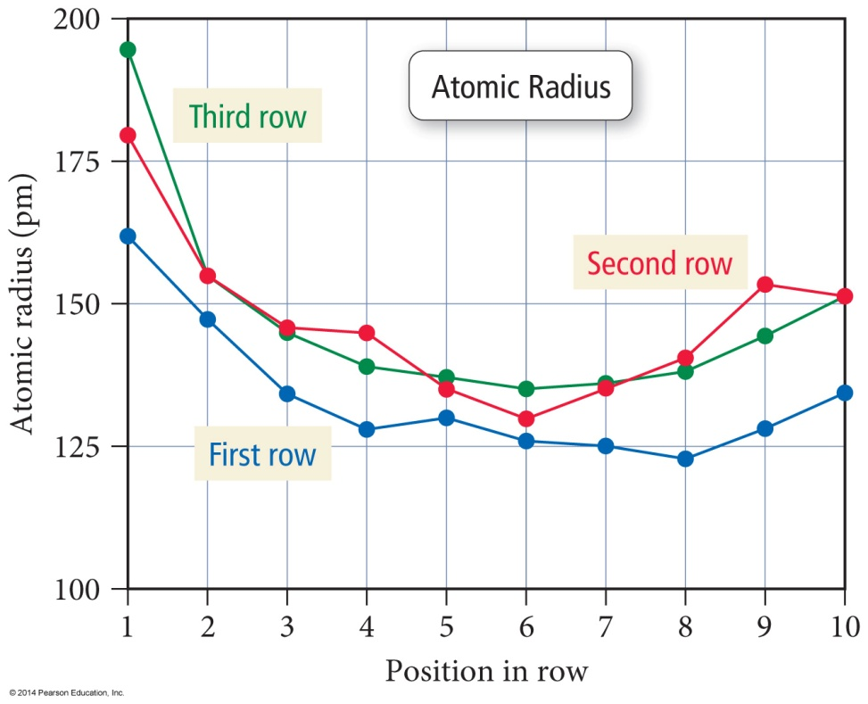
Atomic Size
The atomic radii of all the transition metals are very similar.
  Small increase in size down
  a column
The third transition series
atoms are about the same
size as the second.
  The lanthanide contraction
  is the decrease in expected
  atomic size for the third
  transition series atoms that
  come after the lanthanides.

Slide 8
Why Aren’t the Third Transition Series Atoms Bigger?
14 of the added 32 electrons between the second and third series go into 4f orbitals.
Electrons in f orbitals are not as good at shielding the valence electrons from the pull of the nucleus.
The result is a greater effective nuclear charge increase and therefore a stronger pull on the valence electrons—the lanthanide contraction.

Slide 9
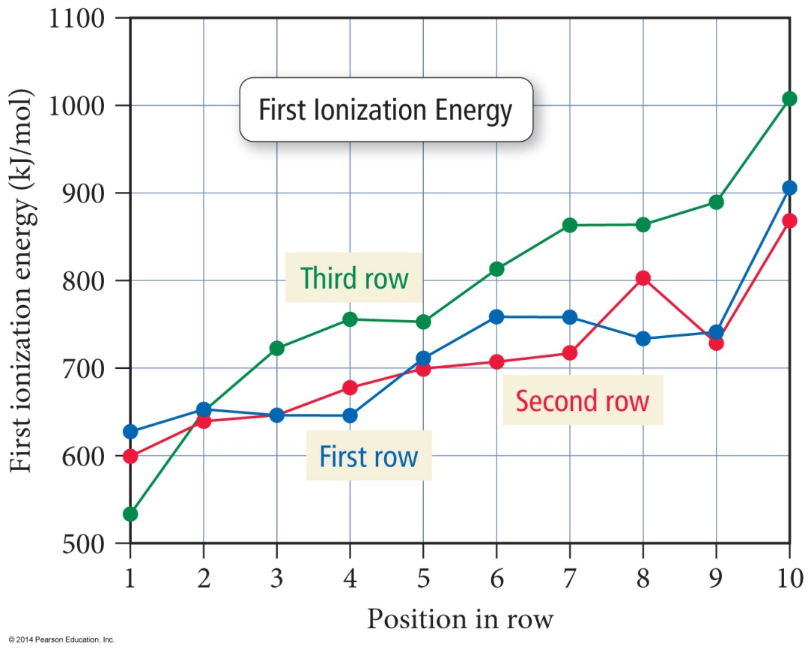
Ionization Energy
The first IE of the transition metals slowly increases across a series.
The first IE of the third transition series is generally higher than the first and second series
  Indicating the valence electrons are held more tightly – why?
  Trend opposite to main group elements

Slide 10
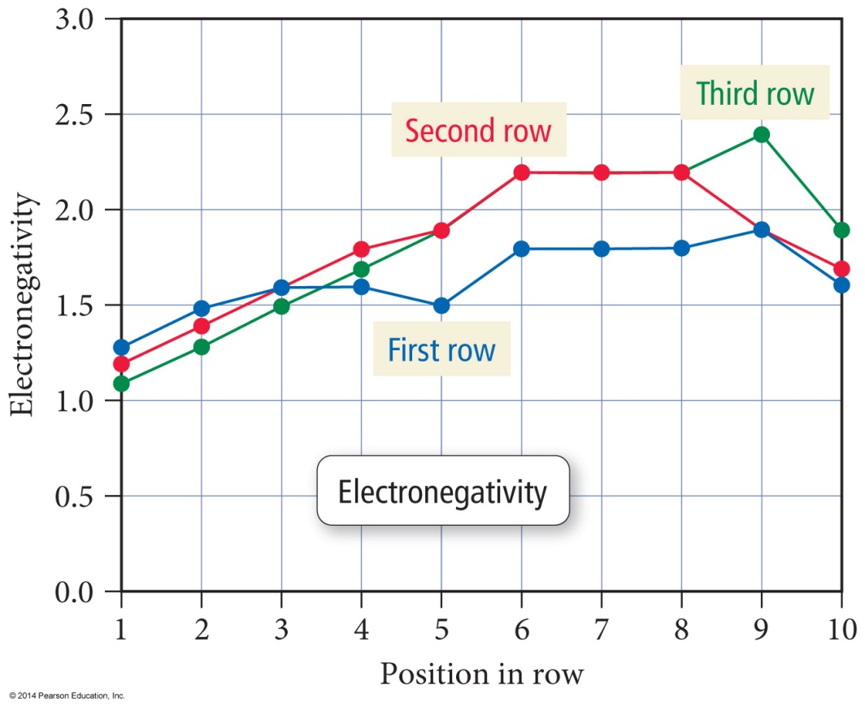
Electronegativity
The electronegativity of the transition metals slowly increases across
a series.
  Except for last element in the series
Electronegativity slightly increases between first and second series, but the third transition series atoms are about the same as the second.
  Trend opposite to main group elements

Slide 11
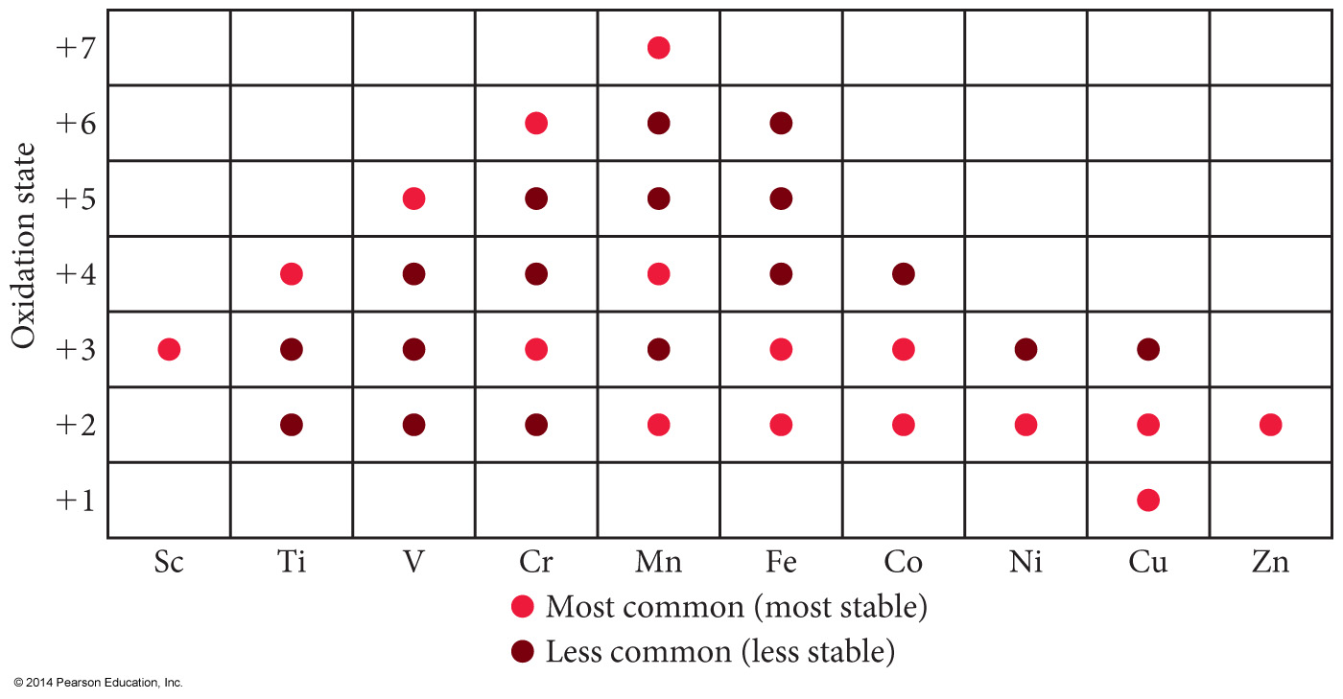
Oxidation States
Unlike main group metals, transition metals often exhibit multiple oxidation states.
They vary by 1.
Highest oxidation state is the same as the group number for groups 3B to 7B.

Slide 12
Complex Ions
When a monatomic cation combines with multiple monatomic anions or neutral molecules it makes a complex ion.
The attached anions or neutral molecules are called ligands.
The charge on the complex ion can then be positive or negative, depending on the numbers and types of ligands attached.

Slide 13
Coordination Compounds
When a complex ion combines with counterions to make a neutral compound it is called a coordination compound.
The primary valence is the oxidation number of the metal.
The secondary valence is the number of ligands bonded to the metal.
  Coordination number
Coordination numbers range from 2 to 12, with the most common being 6 and 4.
CoCl₃ • 6H₂O = [Co(H₂O)₆]Cl₃

Slide 14
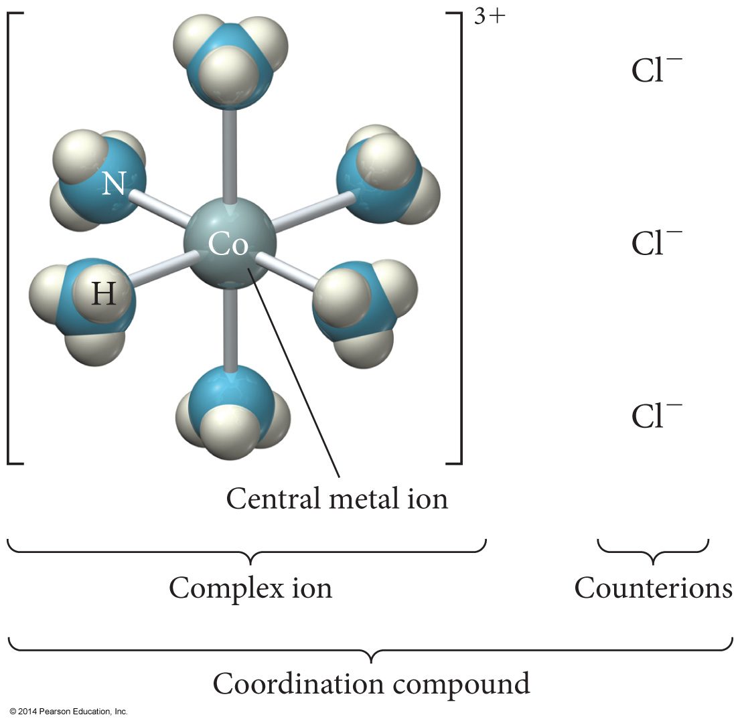
Coordination Compound

Slide 15
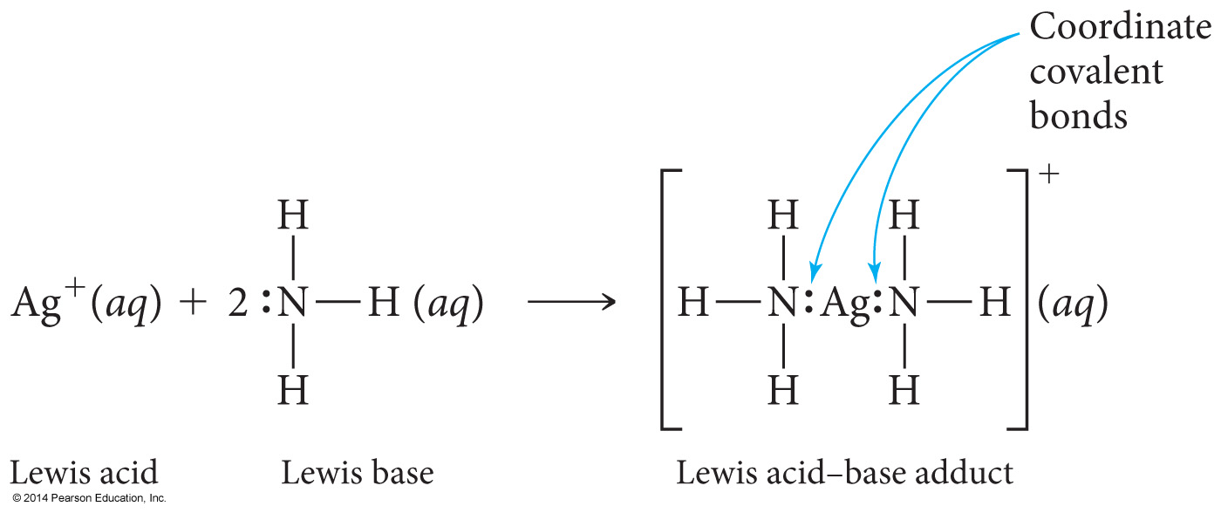
Complex Ion Formation
Complex ion formation is a type of Lewis acid–base reaction.
A bond that forms when the pair of electrons is donated by one atom is called a
coordinate covalent bond.

Slide 16
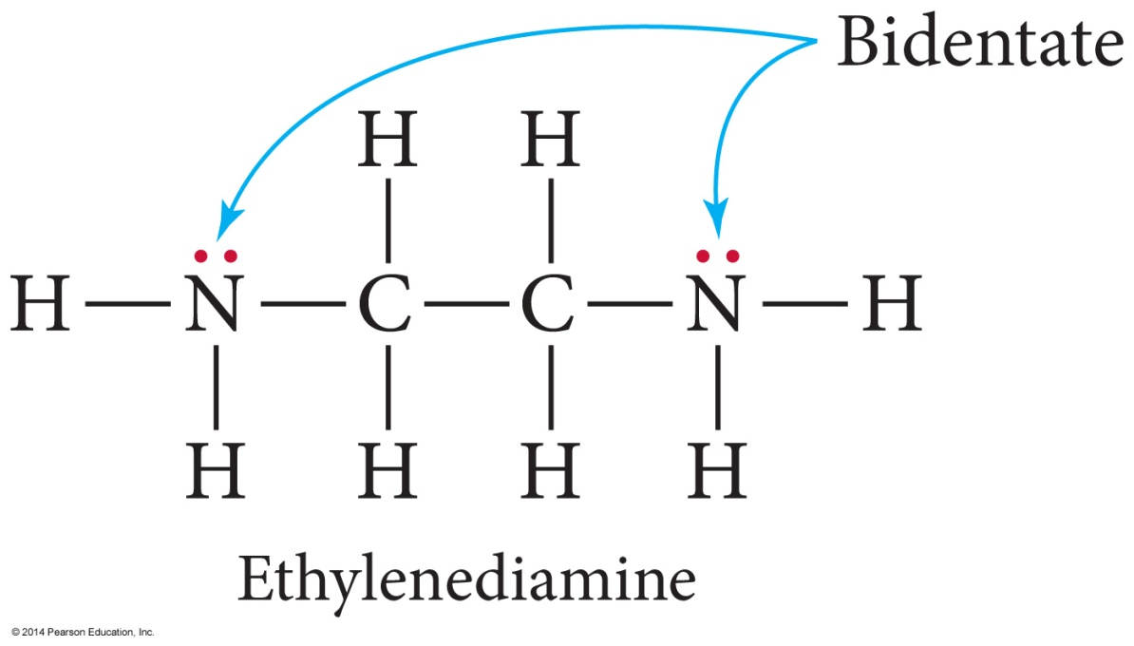
Ligands with Extra Teeth
Some ligands can form more than one coordinate covalent bond with the metal atom.
  Lone pairs on different atoms that are separated enough so that both can bond to the metal
A chelate is a complex ion containing a multidentate ligand.
  The ligand is called the chelating agent.

Slide 17
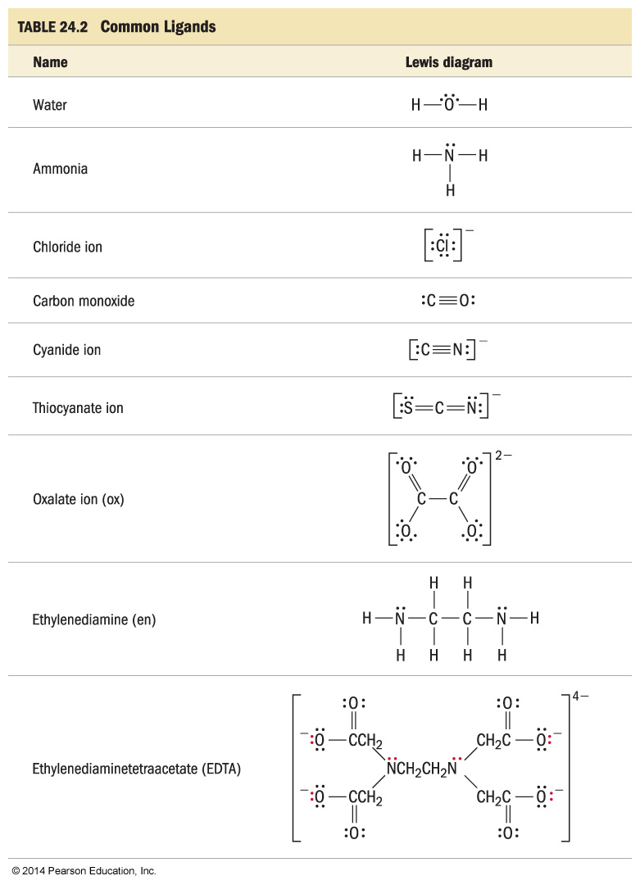
Ligands

Slide 18
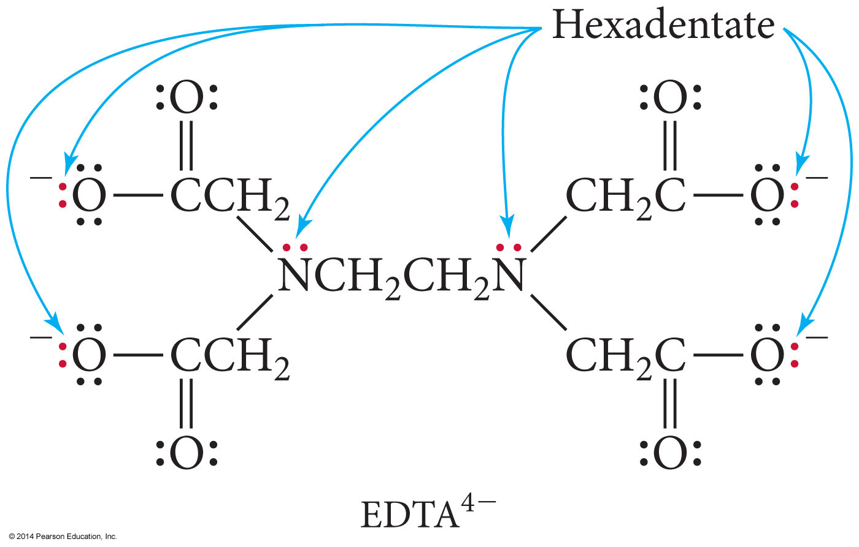
EDTA – A Polydentate Ligand

Slide 19
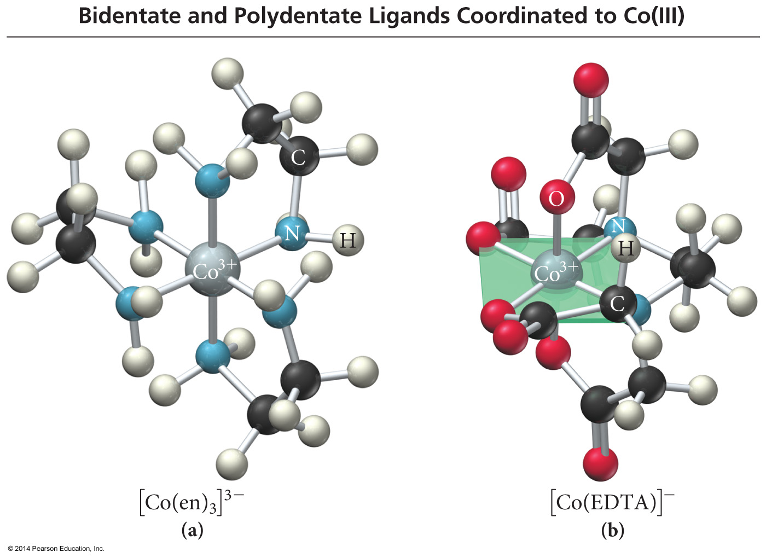
Complex Ions with Polydentate Ligands

Slide 20
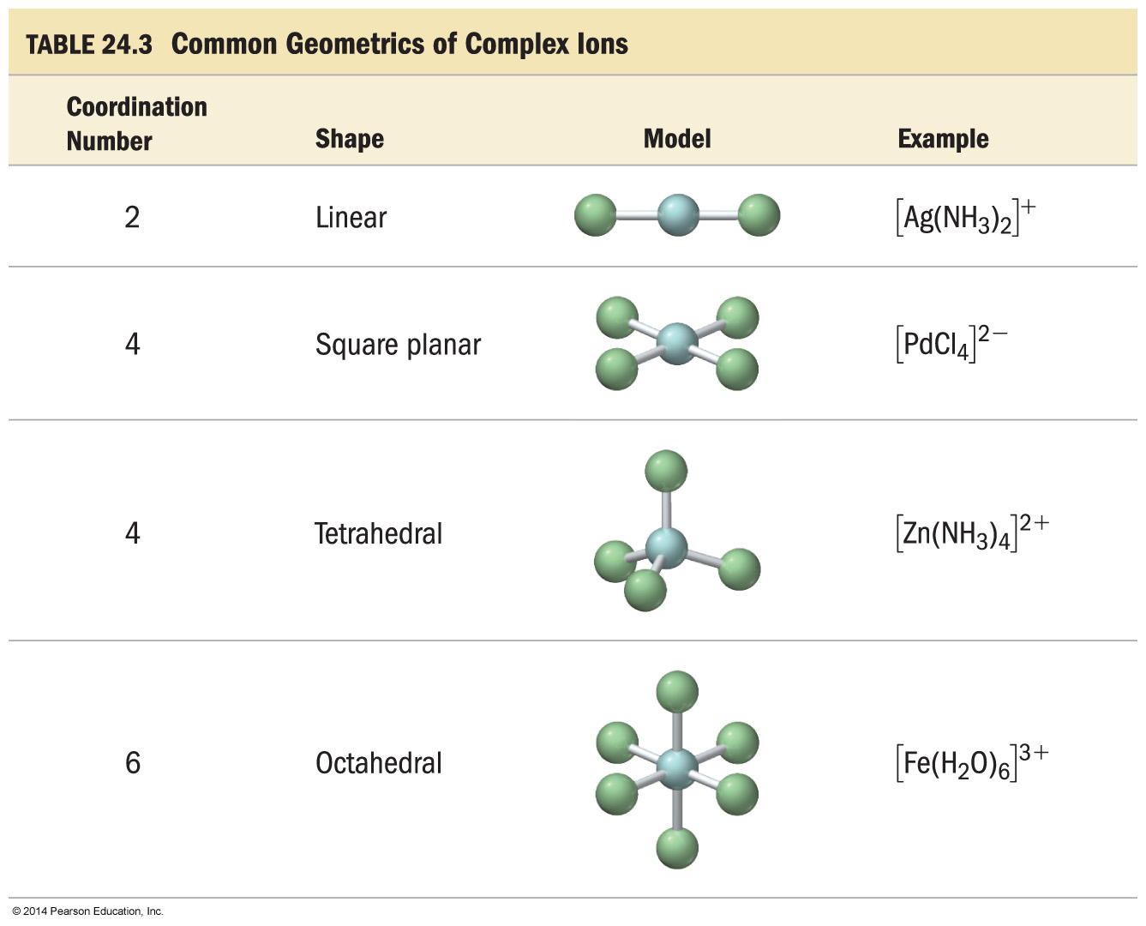
Geometries in Complex Ions

Slide 21
Naming Coordination Compounds
1. Determine the name of the noncomplex ion.
2. Determine the ligand names and list them in alphabetical order.
3. Determine the name of the metal cation.
4. Name the complex ion b:
  a) Naming each ligand alphabetically, adding a prefix in front of each ligand to indicate the number found in the complex ion
  b) Following with the name of the metal cation
5. Write the name of the cation followed by the name of the anion.

Slide 22
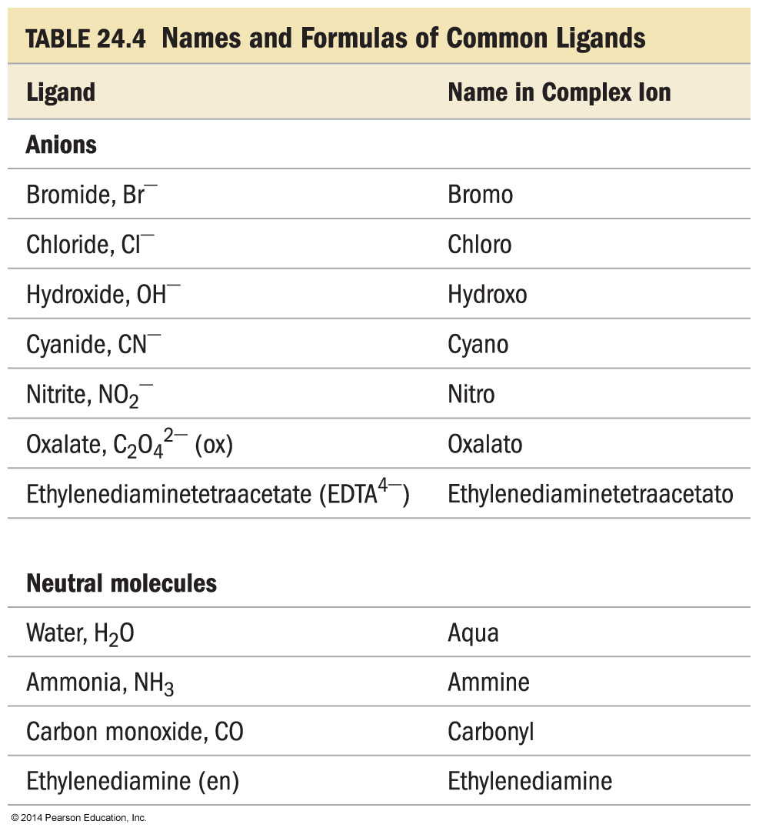
Common Ligands

Slide 23
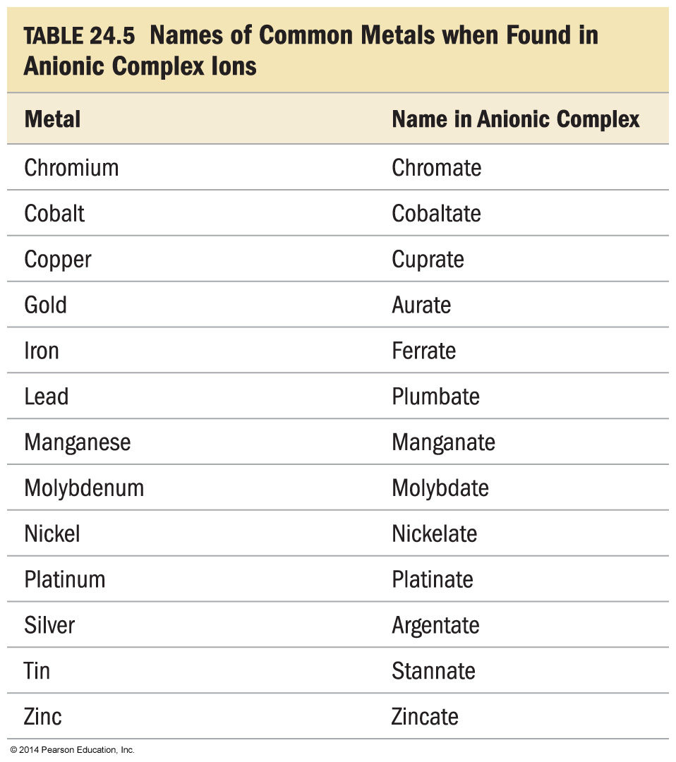
Common Metals found in Anionic
Complex Ions

Slide 24
Examples of Naming Coordination Compounds
 | Name [Cr(H₂O)₅Cl]Cl₂ | Name K₃[Fe(CN)₆]
Identify the cation and anion, and the name of the simple ion. | [Cr(H₂O)₅Cl]²⁺ is a complex cation; Cl⁻ is chloride. | K⁺ is potassium; [Fe(CN)₆]³⁻ is a complex ion.
Give each ligand a name and list them in alphabetical order. | H₂O is aqua; Cl⁻ is chloro. | CN⁻ is cyano.
Name the metal ion. | Cr³⁺ is chromium(III). | Fe³⁺ is ferrate(III) because the complex ion is anionic.
Name the complex ion by adding prefixes to indicate the number of each ligand followed by the name of each ligand followed by the name of the metal ion. | [Cr(H₂O)₅Cl]²⁺ is pentaquochloro-chromium(III). | [Fe(CN)₆]³⁻ is hexacyanoferrate(III).
Name the compound by writing the name of the cation before the anion. The only space is between ion names. | [Cr(H₂O)₅Cl]Cl₂ is pentaquochloro-chromium(III) chloride. | K₃[Fe(CN)₆] is potassium hexacyanoferrate(III).

Slide 25
Isomers
Structural isomers are molecules that have the same number and type of atoms, but they are attached in a different order.
Stereoisomers are molecules that have the same number and type of atoms, and that are attached in the same order, but the atoms or groups of atoms point in a different spatial direction.

Slide 26
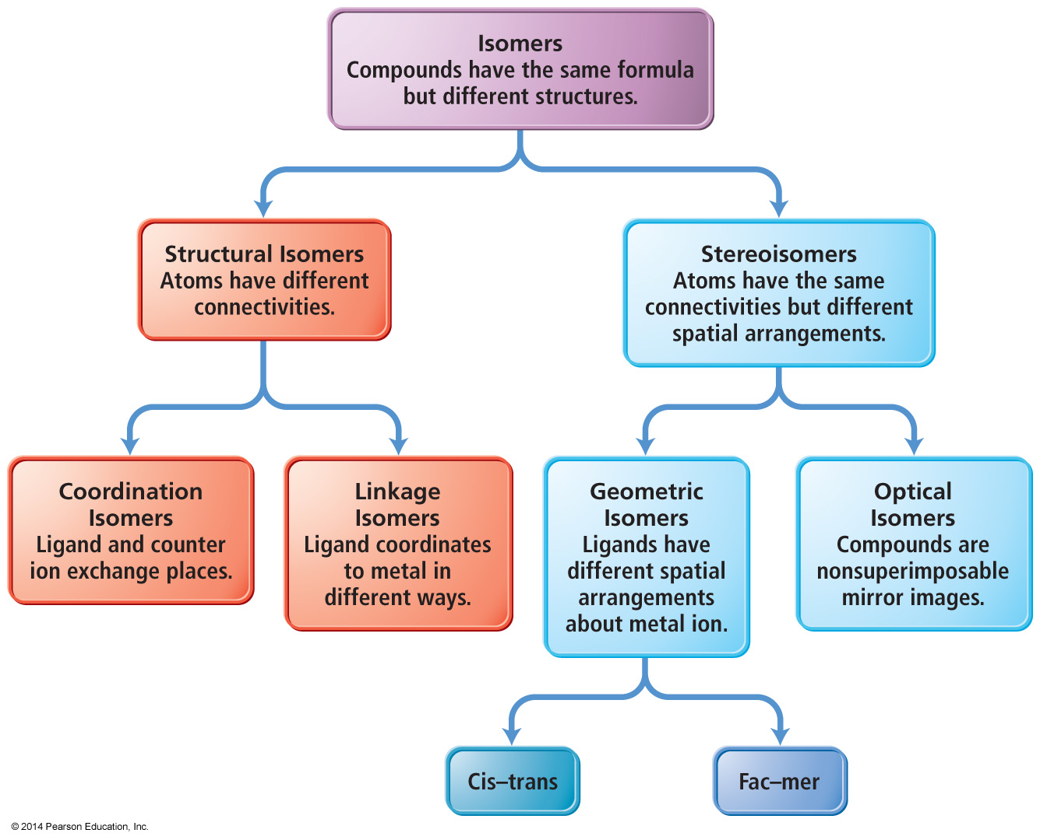
Types of Isomers

Slide 27
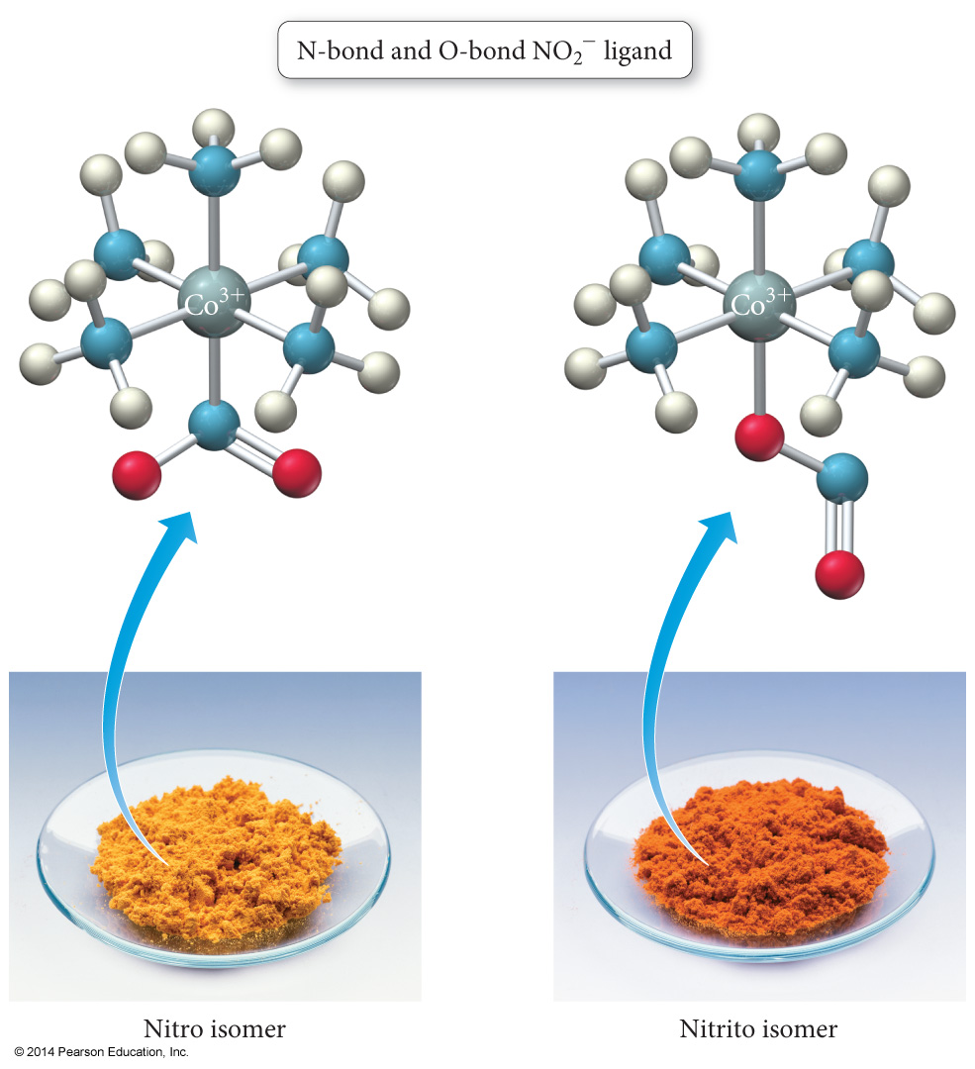
Linkage Isomers
Linkage isomers are structural isomers that have ligands attached to the central cation through different ends of the ligand structure.
Yellow complex = pentamminonitrocobalt(III)
Red complex = pentamminonitritocobalt(III)

Slide 28
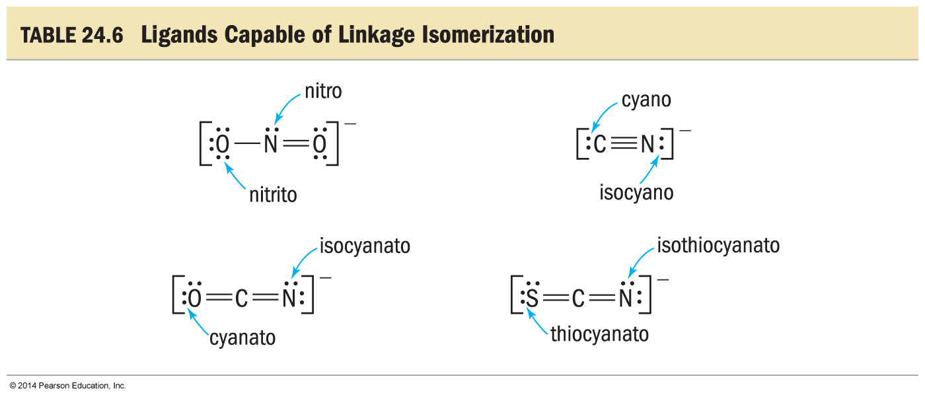
Ligands Capable of Linkage Isomerization

Slide 29
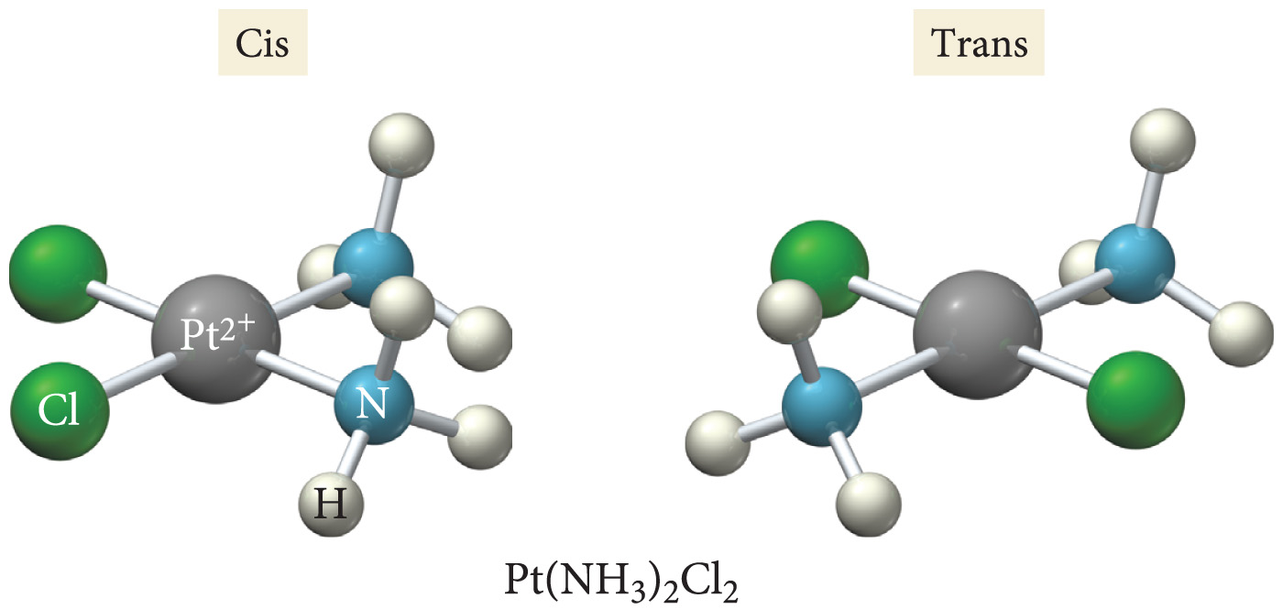
Geometric Isomers
Geometric isomers are stereoisomers that differ in the spatial orientation of ligands.
cis–trans isomerism in square-planar
complexes MA₂B₂

Slide 30
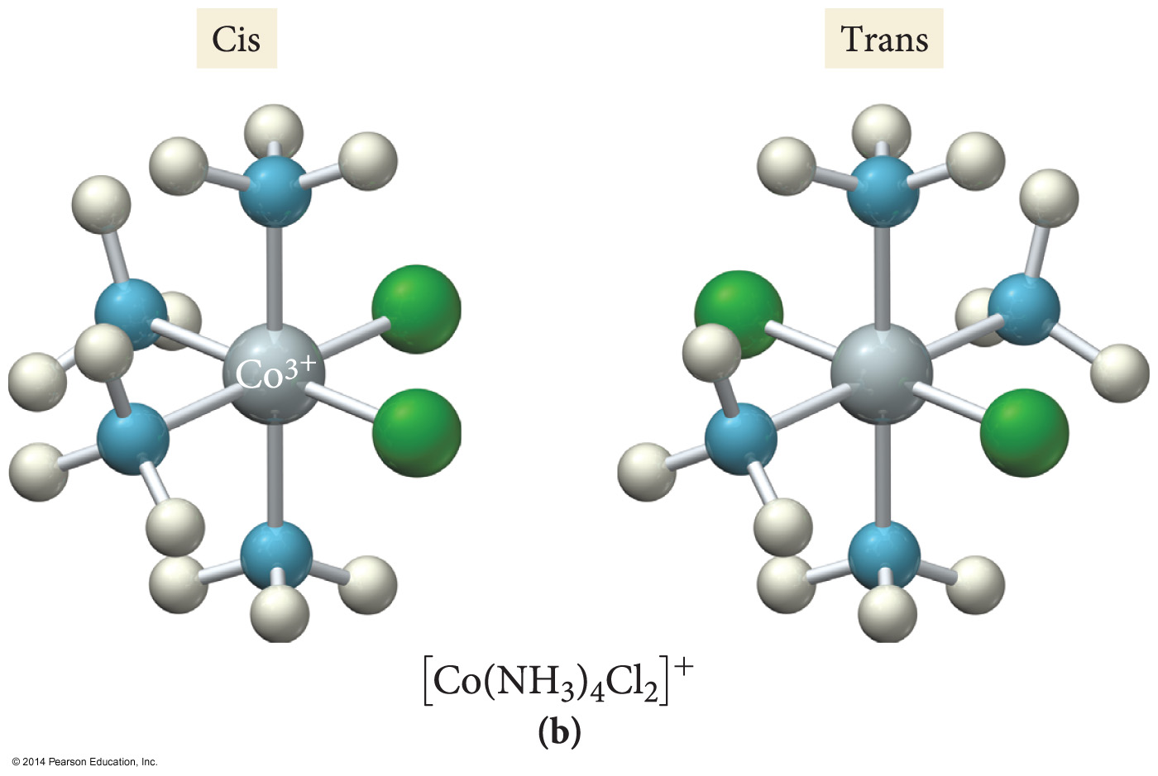
Geometric Isomers
In cis–trans isomerism, two identical ligands are either adjacent to each other (cis) or opposite to each other (trans) in the structure.
cis–trans isomerism in octahedral complexes MA₄B₂

Slide 31
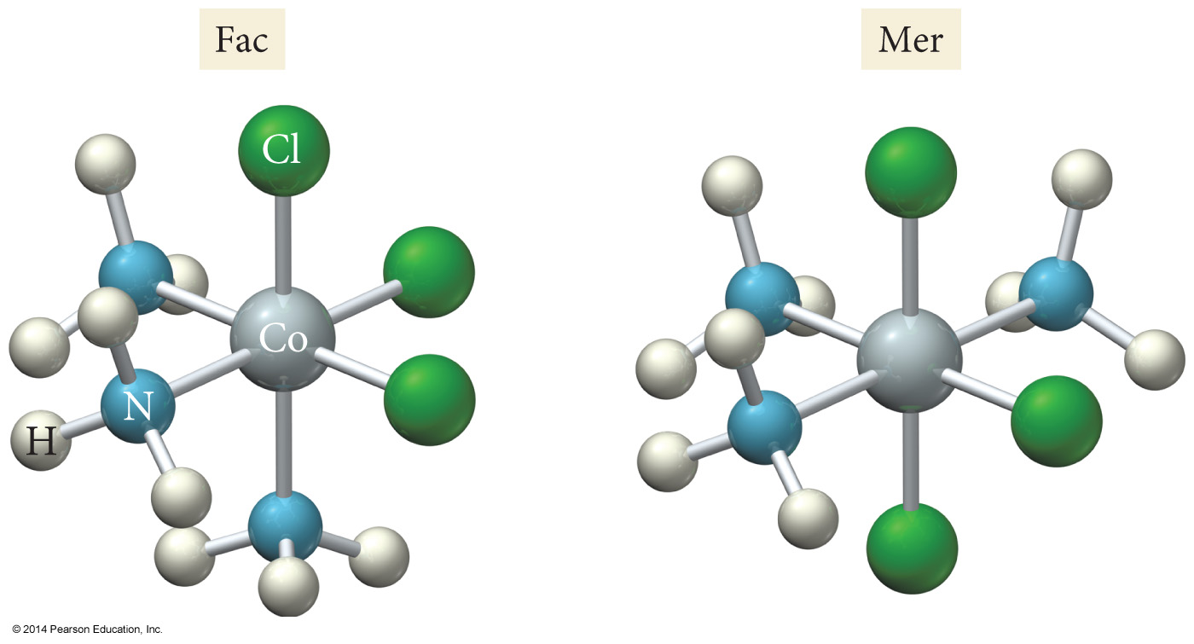


Geometric Isomers
In fac–mer isomerism three identical ligands in an octahedral complex either are adjacent to each other making one face (fac) or form an arc around the center (mer) in the structure.
fac–mer isomerism in octahedral complexes MA₃B₃

Slide 32
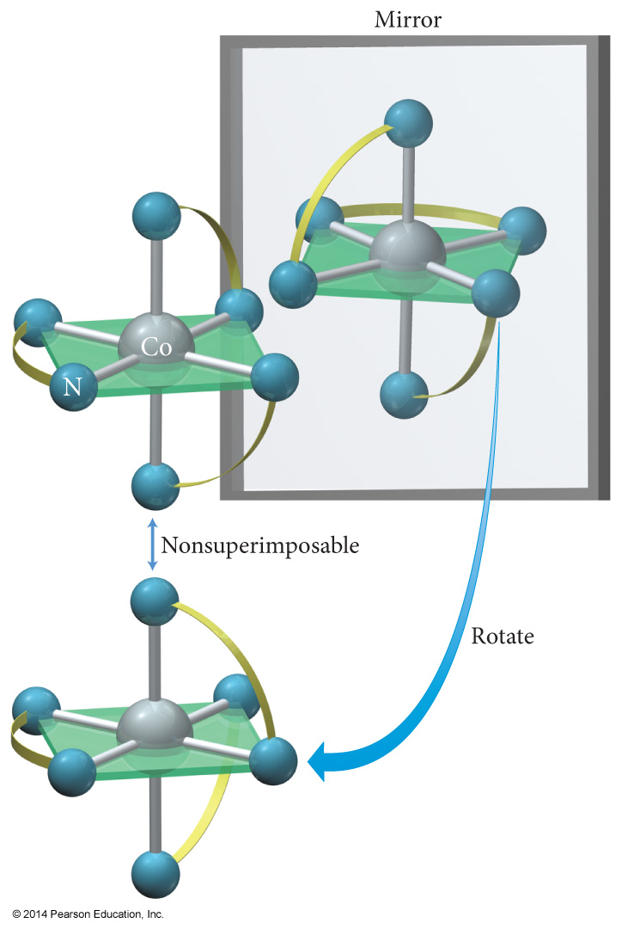
Optical Isomers
[Co(en)₃]³⁺
Optical isomers are stereoisomers that are nonsuperimposable mirror images of each other.

Slide 33
Bonding in Coordination Compounds:
Valence Bond Theory
Bonding takes place when the filled atomic orbital on the ligand overlaps an empty atomic orbital on the metal ion.
It explains geometries well, but doesn’t explain color or magnetic properties.

Slide 34
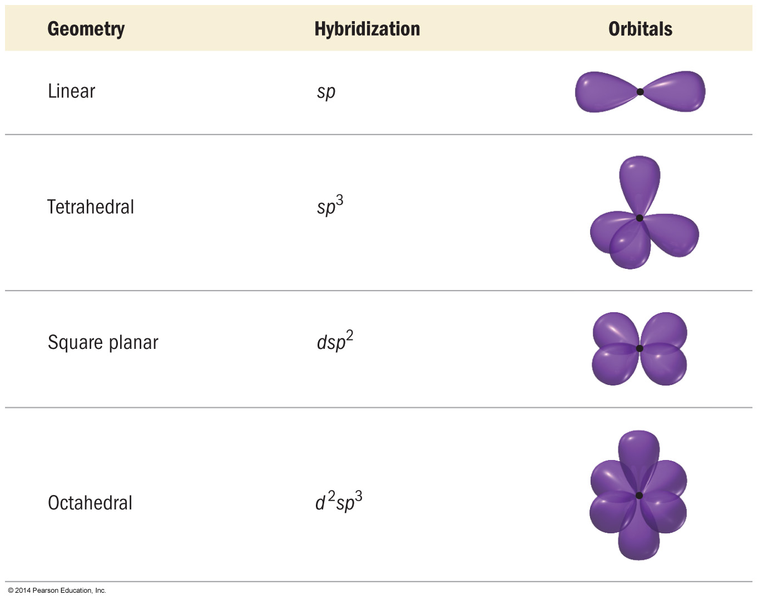
Common Hybridization Schemes in Complex Ions

Slide 35
Bonding in Coordination Compounds:
Crystal Field Theory
Bonds form due to the attraction of the electrons on the ligand for the charge on the metal cation.
Electrons on the ligands repel electrons in the unhybridized d orbitals of the metal ion.
The result is the energies of the d orbitals are split.
The difference in energy depends on the complex formed and the kinds of ligands.
  Crystal field splitting energy
  Strong field splitting and weak field splitting

Slide 36
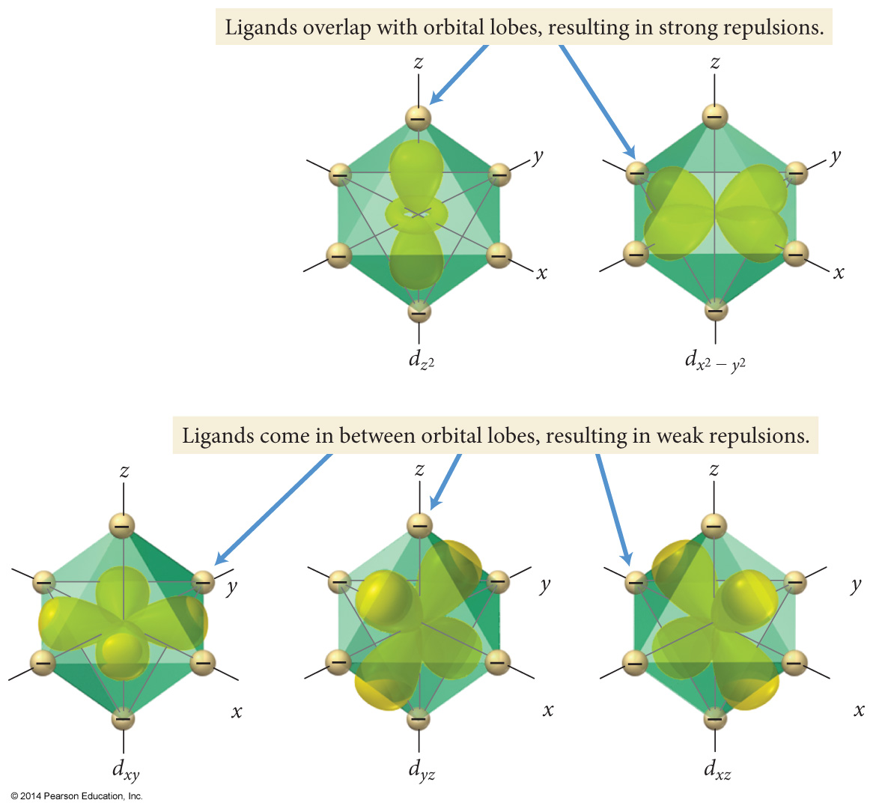
Crystal Field Splitting
The ligands in an octahedral complex are located in the same space as the lobes of the orbitals.

Slide 37
Crystal Field Splitting
The repulsions between electron pairs in the ligands and any potential electrons in the d orbitals result in an increase in the energies of these orbitals.

Slide 38
Crystal Field Splitting
The other d orbitals lie between the axes and have nodes directly on the axes, which results in less repulsion and lower energies for these three orbitals.

Slide 39
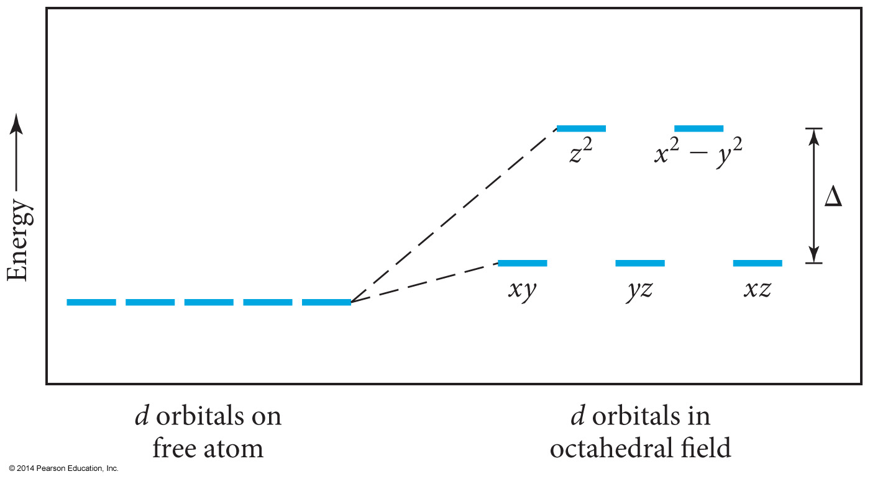
Splitting of d Orbital Energies Due to Ligands in an Octahedral Complex
The size of the crystal field splitting energy, Δ, depends on the kinds of ligands and their relative positions on the complex ion, as well as the kind of metal ion and its oxidation state.

Slide 40
Complex Ion Color and Crystal Field Strength
The colors of complex ions are due to electronic transitions between the split d sublevel orbitals.
The wavelength of maximum absorbance can be used to determine the size of the energy gap between the split d sublevel orbitals.
E_{photon} = hν = hc/λ = Δ

Slide 41
Ligands and Crystal Field Strength
The size of the energy gap depends on what kind of ligands are attached.
  Strong field ligands include CN─ > NO₂─ > en > NH₃.
  Weak field ligands include H₂O > OH─ > F─ > Cl─ > Br─ > I─.
The size of the energy gap also depends on the type of cation.
  Increases as the charge on the metal cation increases
  Co³⁺ > Cr³⁺ > Fe³⁺ > Fe²⁺ > Co²⁺ > Ni²⁺ > Mn²⁺

Slide 42

Magnetic Properties and Crystal Field Strength
The electron configuration of the metal ion with split d orbitals depends on the strength of the crystal field.
The fourth and fifth electrons will go into the higher energy if the field is weak and the energy gap is small, leading to unpaired electrons and a paramagnetic complex.
The fourth through sixth electrons will pair the electrons in the d_{xy}, d_{yz}, and d_{xz} if the field is strong and the energy gap is large, leading to paired electrons and a diamagnetic complex.

Slide 43
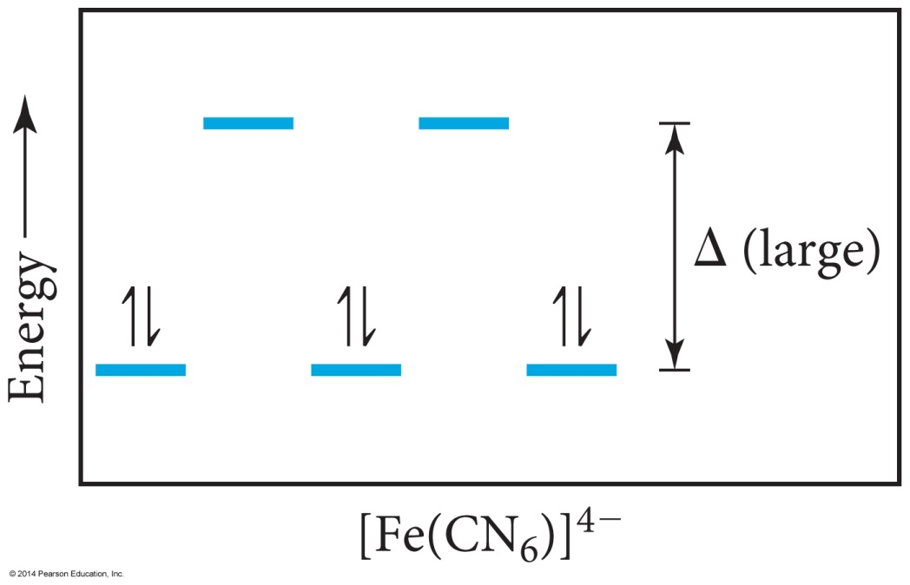
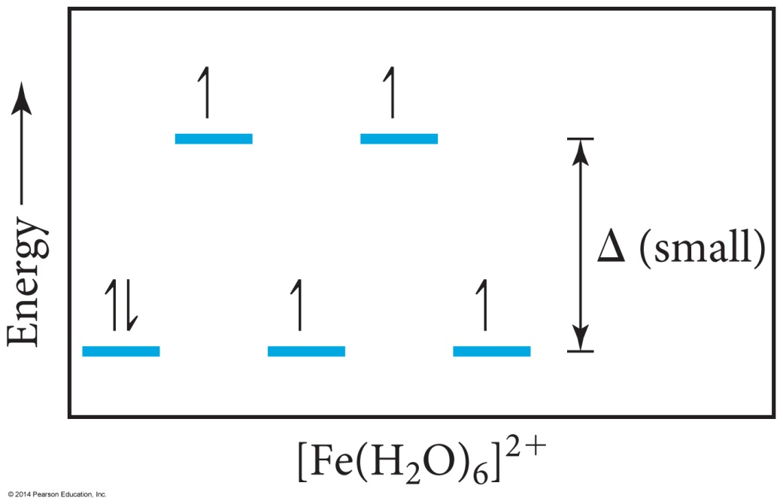
Low Spin and High Spin Complexes
Δ (small)
[Fe(H₂O)₆]²⁺
[Fe(CN)₆]⁴⁻
Diamagnetic
Paramagnetic
Low-spin complex
High-spin complex
Only electron configurations d⁴, d⁵, d⁶, or d⁷ can have low or high spin.

Slide 44
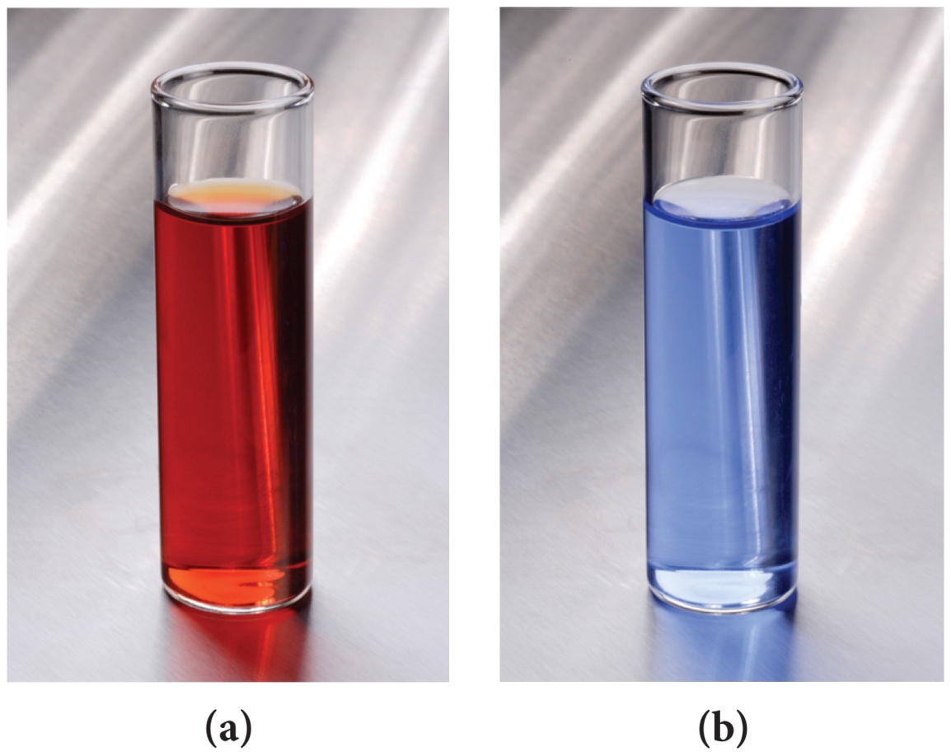
Color and Complex Ions
Transition metal ions show many intense colors in host crystals or solution.
The color of light absorbed by the complexed ion is related to electronic energy changes in the structure of the complex.
  The electron “leaping” from a lower energy state to a higher energy state

Slide 45
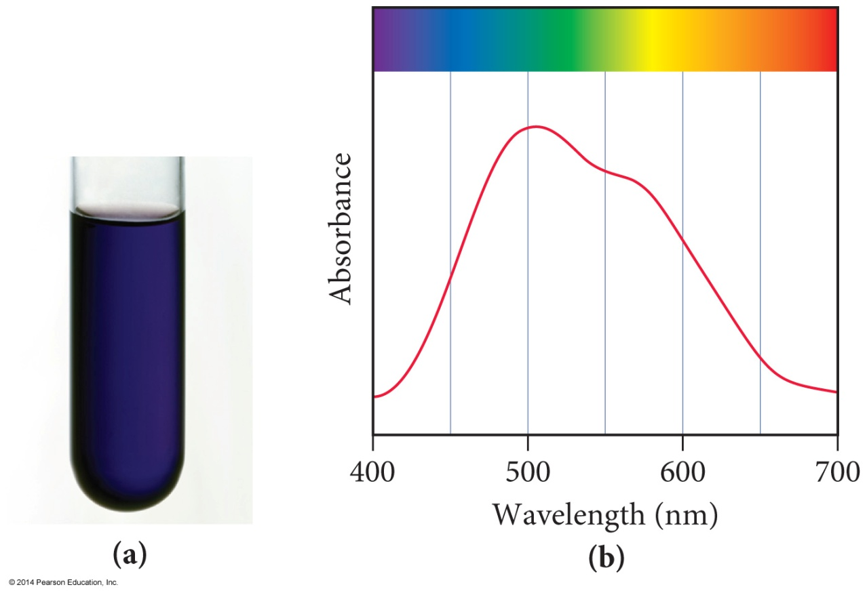
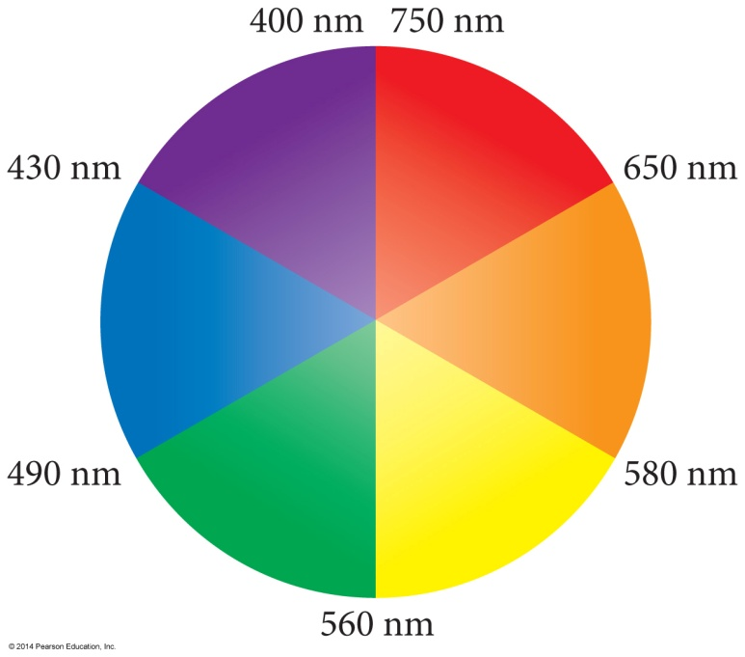
Complex Ion Color
The observed color is the complementary color of the one that is absorbed.

Slide 46
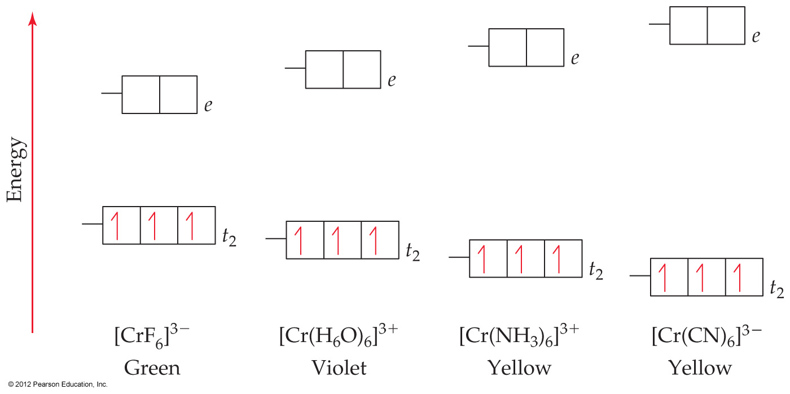

Crystal-Field Theory
The stronger the crystal-field strength of the ligand, the larger the energy gap between
d orbitals, and the shorter the wavelength
of light absorbed by the complex.
Transition
Metals
© 2012 Pearson Education, Inc.

Slide 47
Tetrahedral Geometry and Crystal Field Splitting
Because the ligands interact more strongly with the planar orbitals in the tetrahedral geometry, their energies are raised.
This reverses the order of energies compared to the octahedral geometry.
Almost all tetrahedral complexes are high spin because of reduced metal orbital—ligand interaction.

Slide 48
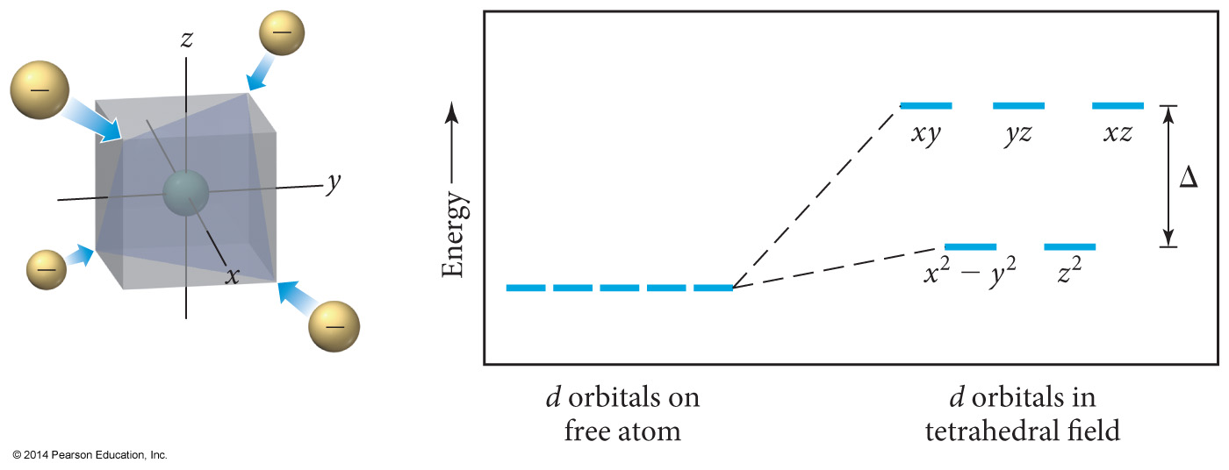
Crystal Field Splitting in the Tetrahedral Geometry

Slide 49
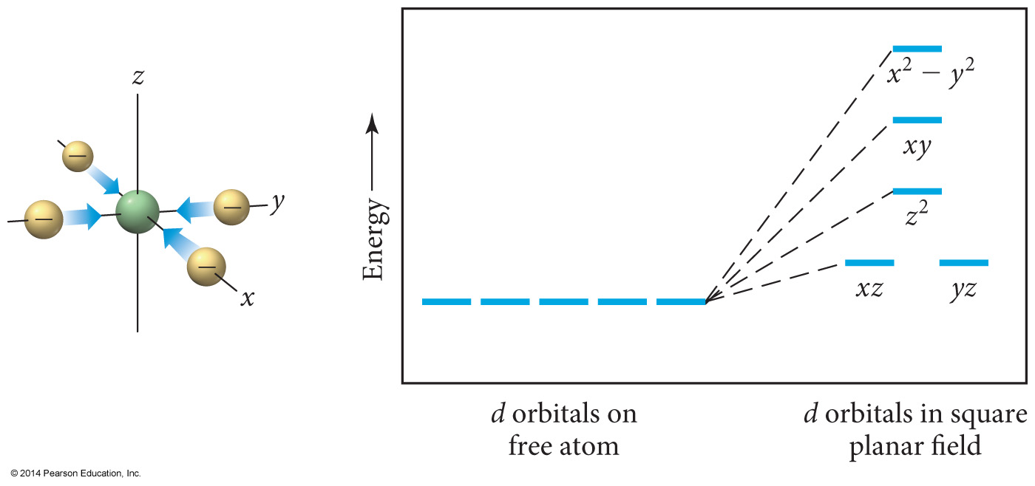
Square Planar Geometry and Crystal Field Splitting
d⁸ metals
  Pt²⁺, Pd²⁺, Ir⁺, Au³⁺
The most complex splitting pattern
Almost all – low-spin complexes

Slide 50
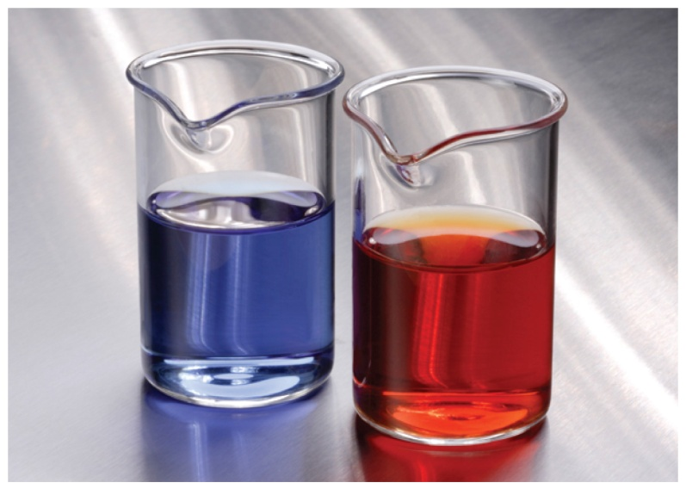
Applications of Coordination Compounds
Extraction of metals from ores
  Silver and gold as cyanide complexes
  Nickel as Ni(CO)₄(g)
Use of chelating agents in heavy metal poisoning
  EDTA for Pb poisoning
Chemical analysis
  Qualitative analysis for metal ions
    Blue = CoSCN⁺
    Red = FeSCN²⁺
    Ni²⁺ and Pd²⁺ form insoluble colored precipitates with dimethylglyoxime.

Slide 51
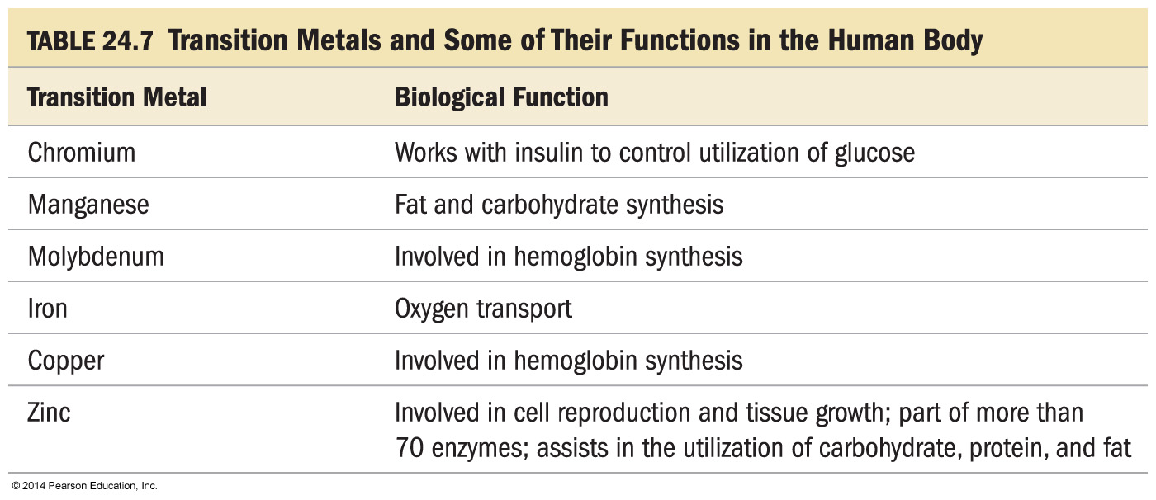
Biomolecules

Slide 52
Applications of Coordination Compounds
Commercial coloring agents
  Prussian blue = mixture of hexacyanoFe(II) and Fe(III)
    Inks, blueprinting, cosmetics, paints

Slide 53
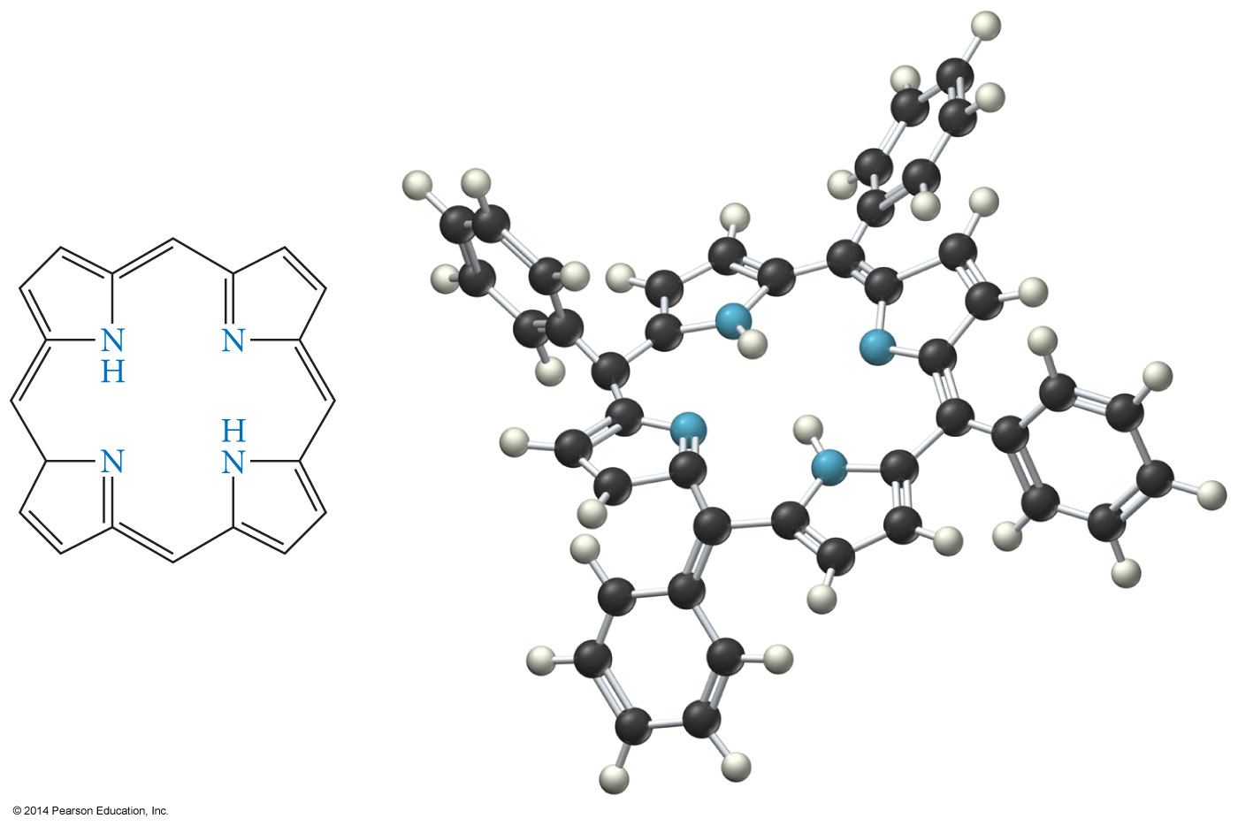
Applications of Coordination Compounds
Biomolecules
  Porphyrin ring

Slide 54
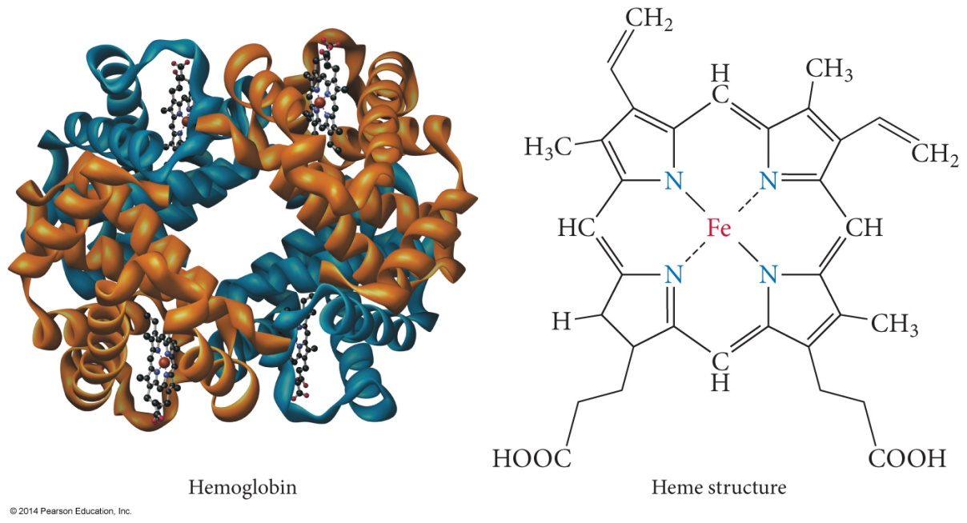
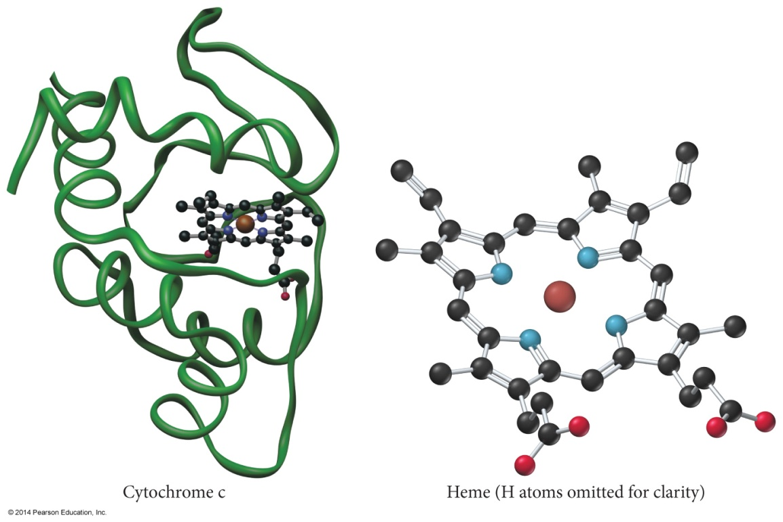
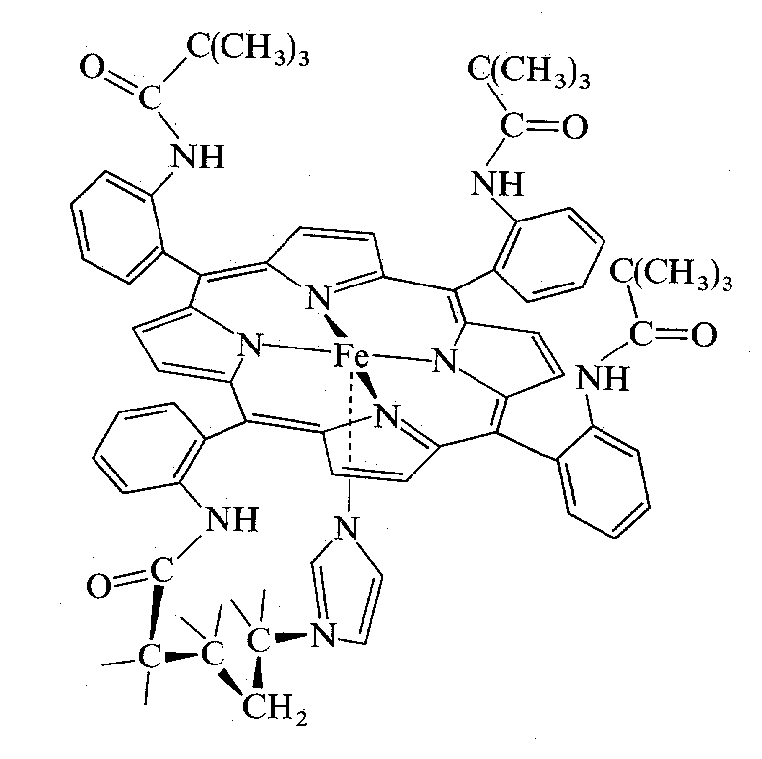
Applications of Coordination Compounds
Biomolecules
  Cytochrome C
  Hemoglobin

Slide 55
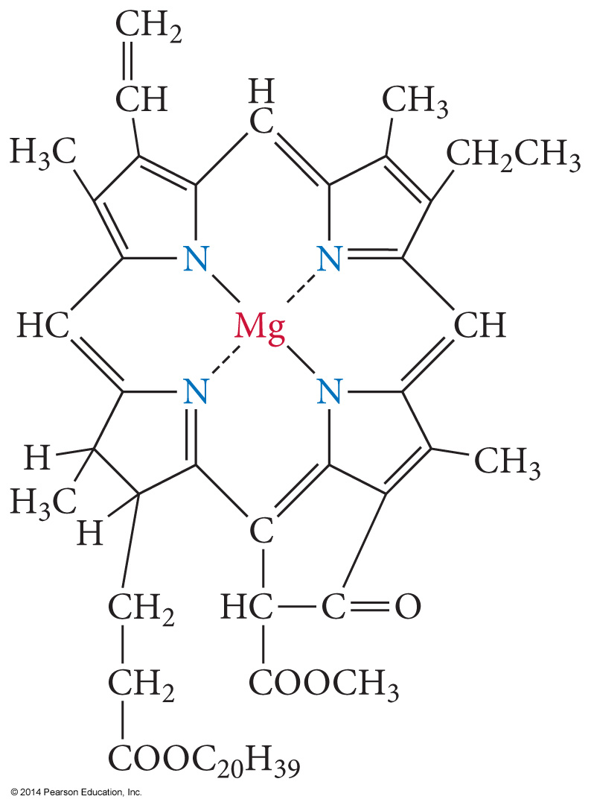
Applications of Coordination Compounds
Biomolecules
  Chlorophyll

Slide 56
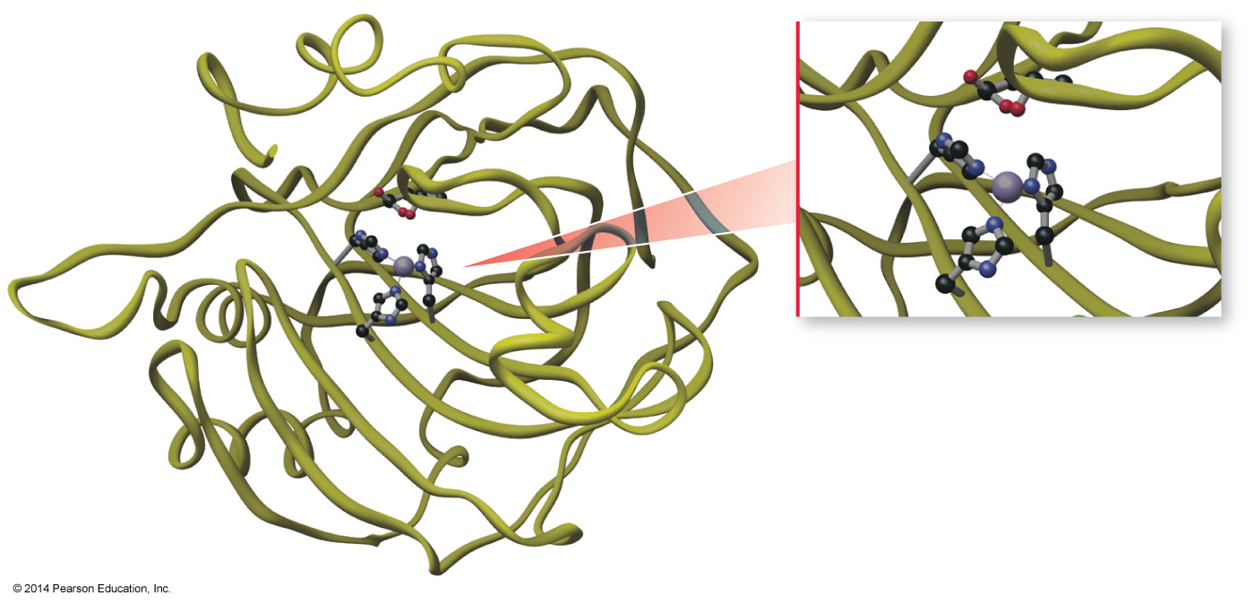
Applications of Coordination Compounds
Carbonic anhydrase
  Catalyzes the reaction between water and CO₂
  Contains tetrahedrally complexed Zn²⁺

Slide 57
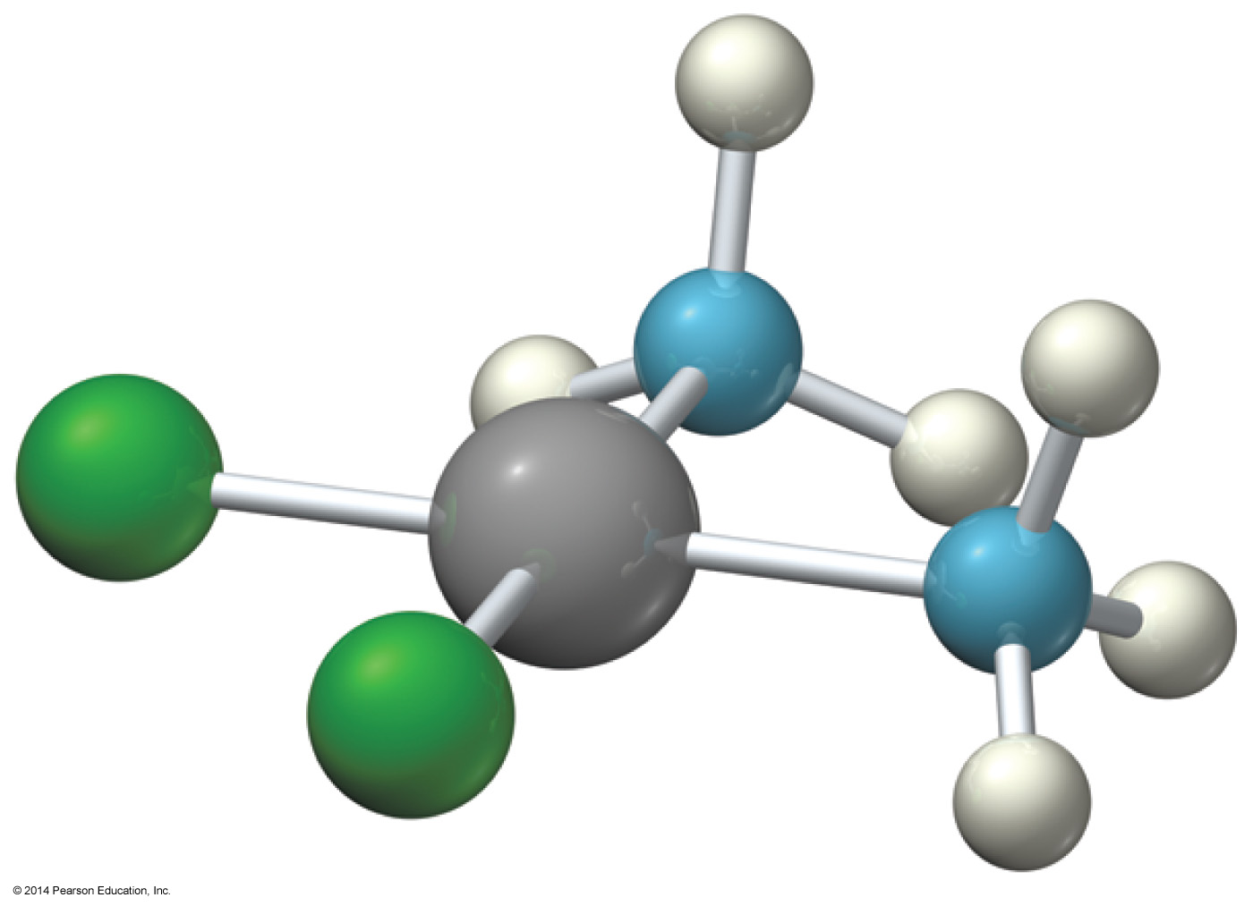
Applications of Coordination Compounds
Drugs and therapeutic agents
  Cisplatin
    Anticancer drug

